Slide 1
Unsupervised Learning Competitive Learning
CSE301 Biocomputation, Week 11, 2016
Bailing Zhang
Computer Science & Software Eng

Slide 2
Recall: Simple Competitive Learning
Update weights for winning neuron
The neuron with largest activation is then adapted
to be more like the input
that caused the excitation
Only the incoming weights of the winner node are modified.

Slide 3
Enforcing fairer competition
Initial position of weight vector of an output unit may be in region with few, if any, patterns (cf problems of k-means)
Some units may never or rarely become a winner, and so weight vector may not be updated preventing it finding richer part of pattern space →DEAD UNIT
More efficient to ensure a fairer competition where each unit has an equal chance of representing some part of training data

Slide 4
Leaky learning
Modify weights of both winning and losing units but at different
learning rates
where η _{w} (t) >> η _{L} (t)
which has the effect of slowly moving losing units towards denser
regions pattern space.
Many other ways as we will discuss later on

Slide 5
Vector Quantization: Application of competitive learning
Idea: Categorize a given set of input vectors into M classes using competitive learning algorithms, and then represent any vector just by the class into which it falls
Important use of competitive learning (esp. in data compressing): divides entire pattern space into a number of separate subspaces - set of M units represent set of prototype vectors: CODEBOOK (cf k-means)
new pattern x is assigned to a class based on its closeness to a prototype vector using Euclidean distances (cf k-nearest neighbours, kernel density estimation)

Slide 6
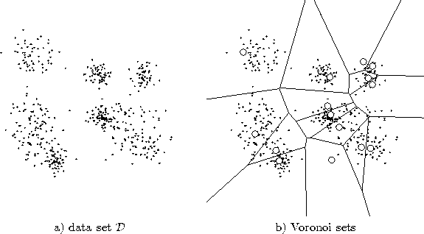
Data set D
Voronoi sets

Slide 7
Vector Quantization
A codebook (a set of centroids/codewords):
A quantization function:
K-means can be used to construct the codebook
Often, the nearest-neighbor function

Slide 8
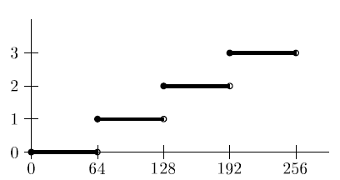
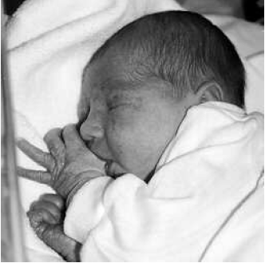
Image Compression by VQ
Amapping for uniform quantization
quantized to
128 greyscales
quantized to
64 greyscales
quantized to
32 greyscales
quantized to
16 greyscales

Slide 9
NN with Competition Mechanism
Competition is important for NN
Competition between neurons has been observed in biological nerve systems
Competition is important in solving many problems
To classify an input pattern into one of the m classes
idea case: one class node has output 1, all other 0 ;
often more than one class nodes have non-zero output
x_1
C_1
x_n
C_m
INPUT
CLASSIFICATION
If these class nodes compete with each other, maybe only one will win eventually and all others lose (winner-takes-all). The winner represents the computed classification of the input

Slide 10
More on Winner-Takes-All
Among all competing nodes, only one will win and all others will lose
We mainly deal with single winner WTA, but multiple winners WTA are possible (and useful in some applications)
Easiest way to realize WTA: have an external, central arbitrator (a program) to decide the winner by comparing the current outputs of the competitors (break the tie arbitrarily)
This is biologically unsound (no such external arbitrator exists in biological nerve system).

Slide 11
Ways to realize competition in Neural Networks
Lateral inhibition (Maxnet, Mexican hat)
output of each node feeds to others through inhibitory connections (with negative weights)
x_{i}
x_{j}
1
2
3
A specific competitive net that performs Winner Take All (WTA) competition is the Maxnet.

Slide 12
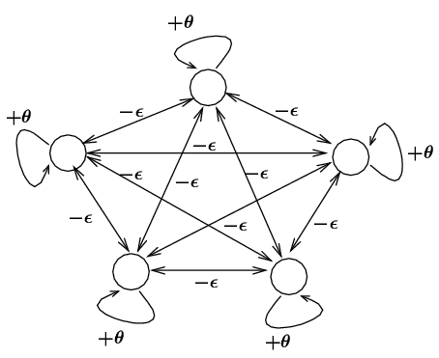
Fixed-weight Competitive Nets
Maxnet
Lateral inhibition between competitors

Slide 13
Fixed-weight Competitive Nets
Example
θ = 1, ε = 1/5 = 0.2
x(0) = (0.5 0.9 1 0.9 0.9 ) initial input
x(1) = (0 0.24 0.36 0.24 0.24 )
x(2) = (0 0.072 0.216 0.072 0.072)
x(3) = (0 0 0.1728 0 0 )
x(4) = (0 0 0.1728 0 0 ) = x(3)
stabilized

Slide 14
Notes:
Competition: iterative process until the net stabilizes (at most one node with positive activation)
where m is the # of competitors
too small: takes too long to converge
too big: may suppress the entire network (no winner)

Slide 15
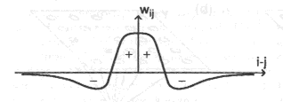
More general form of competition: Mexican Hat
Architecture: For a given node,
close neighbors: cooperative (mutually excitatory , w > 0)
farther away neighbors: competitive (mutually inhibitory, w < 0)
too far away neighbors: irrelevant (w = 0)
Need a definition of distance (neighborhood):
one dimensional: ordering by index (1,2,…n)
two dimensional: lattice
w₂
w₂
w₃
w₃

Slide 16
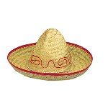
MEXICAN Hat Network
The activation of unit x_{i} at time t is given by:
where the terms in the summation are the weighted signal from other units (cooperative and competitive neighbors) at the previous time step.

Slide 17
Mexican Hat Network
The lateral connections are used to create a competition between neurons. The neuron with the largest activation level among all neurons in the output layer becomes the winner. This neuron is the only neuron that produces an output signal. The activity of all other neurons is suppressed in the competition.
The lateral feedback connections produce excitatory or inhibitory effects, depending on the distance from the winning neuron. This is achieved by the use of a Mexican Hat function , which describes synaptic weights between neurons in the output layer.

Slide 18
Example

Slide 19
Equilibrium:
negative input = positive input for all nodes
winner has the highest activation;
its cooperative neighbors also have positive activation;
its competitive neighbors have negative (or zero) activations.

